Slide 1

Customer retention program
Project results
Thorsten weber – data analyst – 2025-07-11

Slide 2
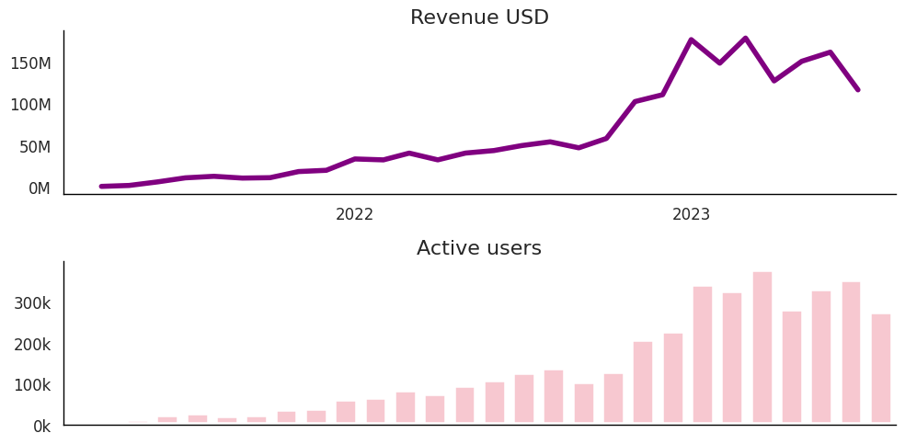
Travel Tide has been very successful in attracting users generating hypter-Growth – until recently.
Downwards- trend

Slide 3

our newly acquired users often don‘t book and worse don‘t return. Soon the bucket could be empty.
1 million active users in 2013
Only 5700 with +7 sessions

Slide 4




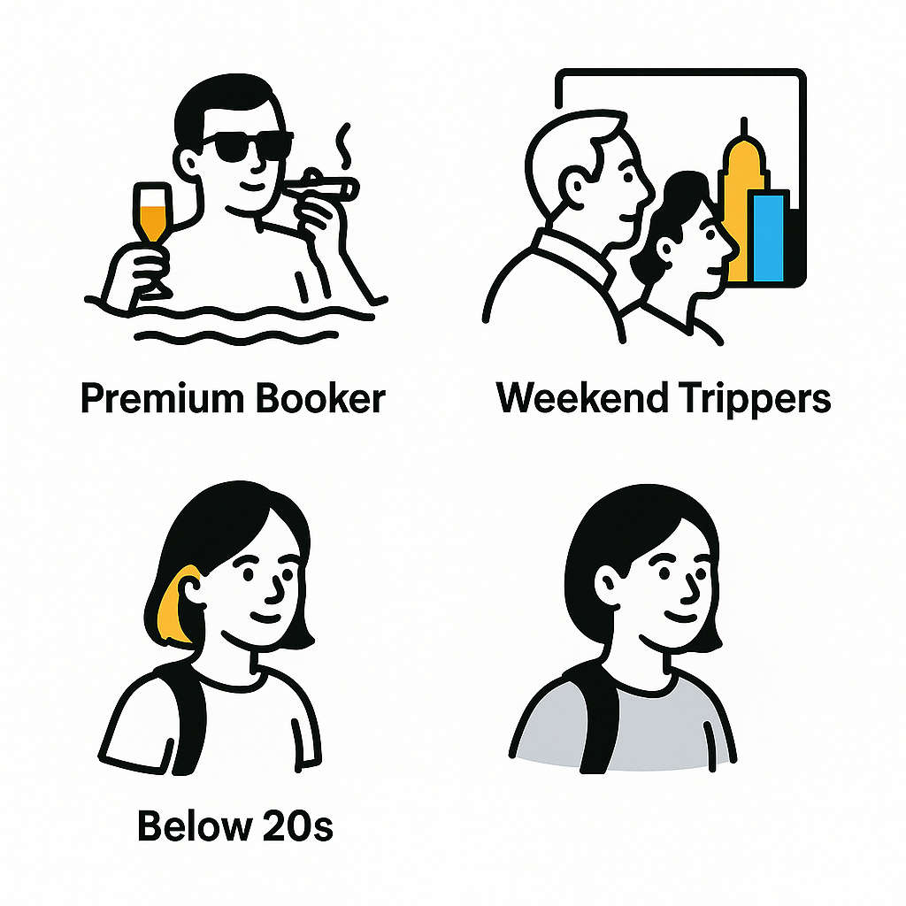



Our effective retention program generates loyalty by individualized perks and targeted communication.
Building Blocks
User Groups
Growth potential
1
Status Program & long-term rewards
Targeted perks & 1:1 communication increases recurring bookings
2
Win-back reduces cancelation
Groups
3

Slide 5
Potential Business Value is outstanding
+ 3.2 million USD revenue increase
+ 30% customer return rates
+ 15% spend per order (cross/upselling)
+ 20% revenue uplift
+ Up to 50% higher CLV
- Customer acquisition costs

Slide 6
What’s next?
Next steps
Recommendations
Conduct 4 week pilot study of program
Optimization (A/B Tests, user survey)
Set-up sourcing and delivery of perks
Develop Tableau performance dashboard
Roll-out optimized loyalty program
Introduce bi-yearly customer satisfaction survey
Address growth potential in underserved target groups (male, below 20s, families, groups)
Address data anomalies
PoC for RFM oder k-means clustering

